Slide 1
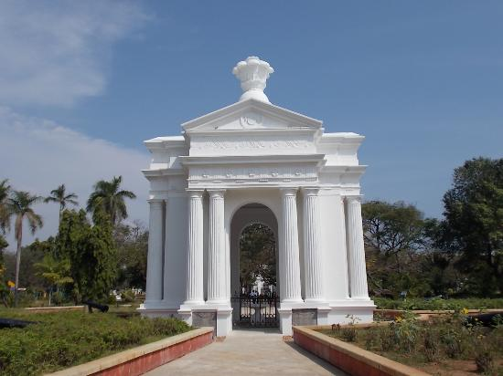
GOVERNMENT OF PUDUCHERRY
MID-DAY MEAL SCHEME 2018-19

Slide 2
ACHIEVEMENT FOR THE YEAR 2017-18
LEVEL | STANDARD | PAB APPROVAL | STUDENTS STRENGTH | MDM BENEFICIARIES | Percentage
Primary | I to V | 23093 | 31657 | 26231 | 83%
Upper Primary | VI to VIII | 18064 | 25242 | 19252 | 76%
Total |  | 41157 | 56899 | 45466 | 80%
Total no. of schools =431

Slide 3
Beneficiaries for the year 2016-17 =41157 Beneficiaries for the year 2017-18=45466 =4309
PROGRESS FOR THE YEAR 2017-18
LEVEL | STANDARD | PAB APPROVAL (2016-17) | STUDENTS STRENGTH | MDM BENEFICIARIES (2017-18)
Primary | I to V | 23093 | 31657 | 26231
Upper Primary | VI to VIII | 18064 | 25242 | 19235
Pre-Primary | LKG & UKG |  | 7382 | 6711
High School & HSS | IX TO XII STD |  | 38098 | 22789
Total |  | 41157 | 102379 | 74966

Slide 4
MENU
MONDAY | Rice, Mixed Vegetable Sambar, Carrot Poriyal & Egg
TUESDAY | Variety Rice – Tomato with Potato Poriyal
WEDNESDAY | Rice, Mixed Vegetable Sambar, Beet Root Poriyal & Egg
THURSDAY | Variety Rice – Tamarind Rice with Potato Poriyal
FRIDAY | Rice, Mixed Vegetable Sambar, Raw Banana Poriyal & Egg
Black channa/Mochai provided on Non Egg days

Slide 5
Best Practices:-
Implemented from Pre-primary to XII-std
State Share - Rs.1311.51 Lakhs for the implementation of MDM for the year 2017-18.
Break Fast scheme 100ml of Hot milk to the students – Rs.925 lakhs under State fund.
Food is prepared in modernized central kitchens and cluster kitchens in a hygienic atmosphere.
Egg is provided to students thrice a week amount Rs.200 lakhs(U.T Fund)
Safe drinking water has been ensured by installing RO System with multiple water systems for hand washing.
Procurement of Agmark diet articles through Co-operative institutions / Govt. undertakings by limited tender system
Conversion of LPG based central kitchen and school based cluster kitchen under U.T Fund

Slide 6
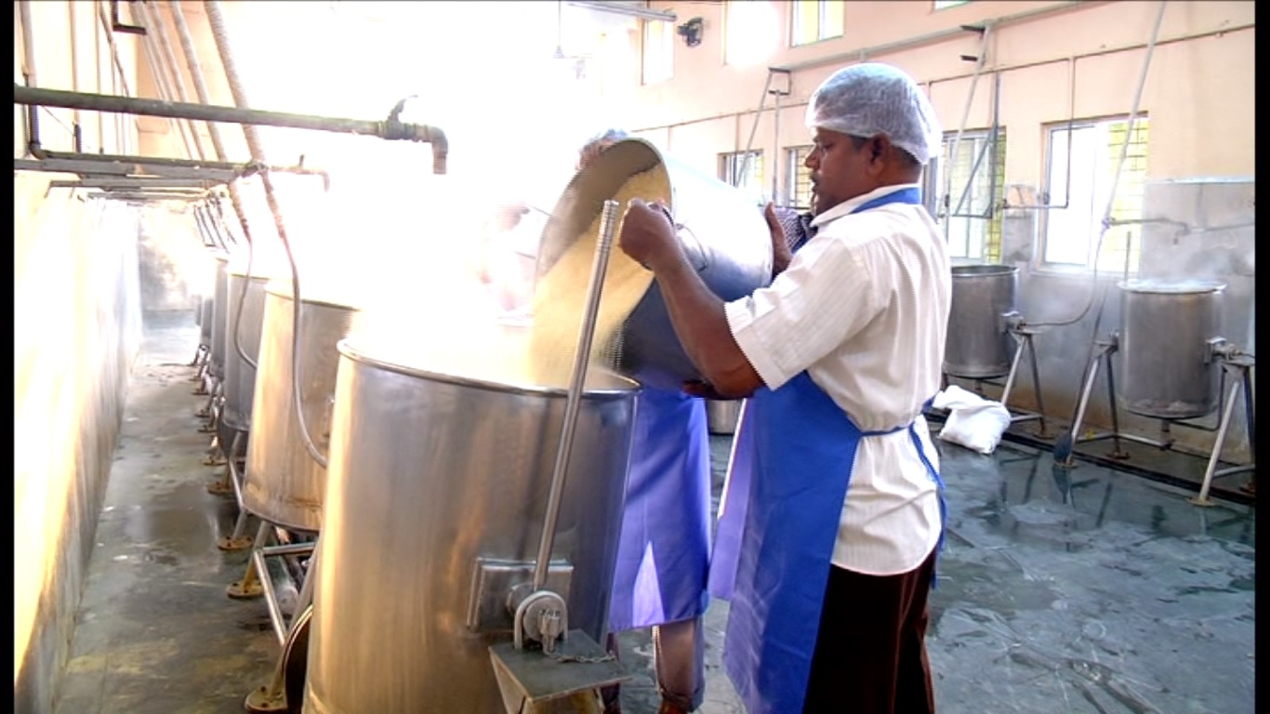
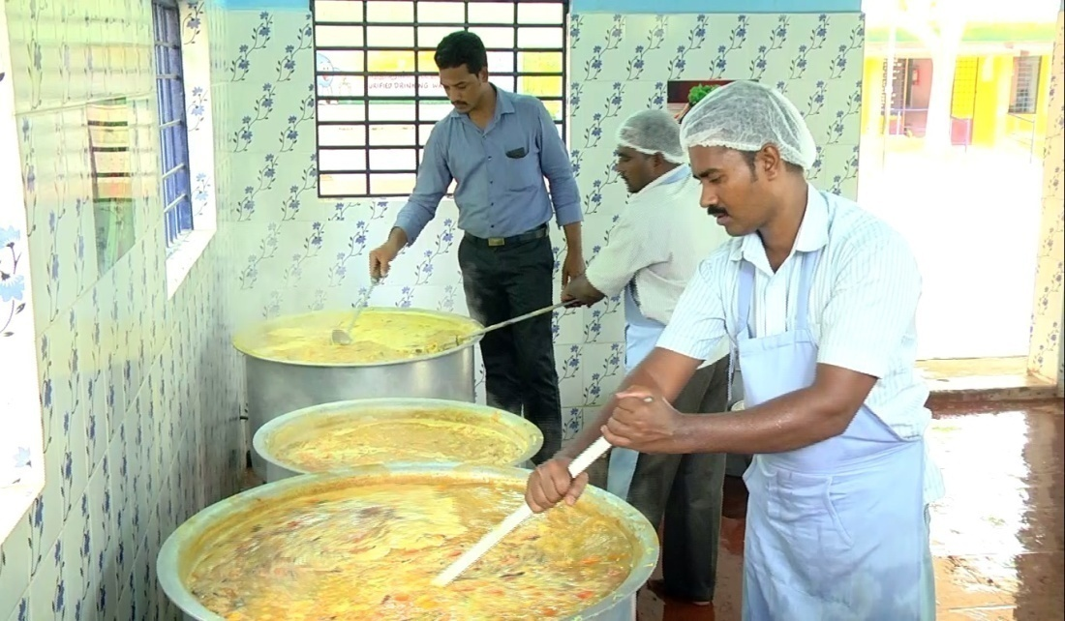
Cooking Process in central kitchen
in cluster kitchen

Slide 7
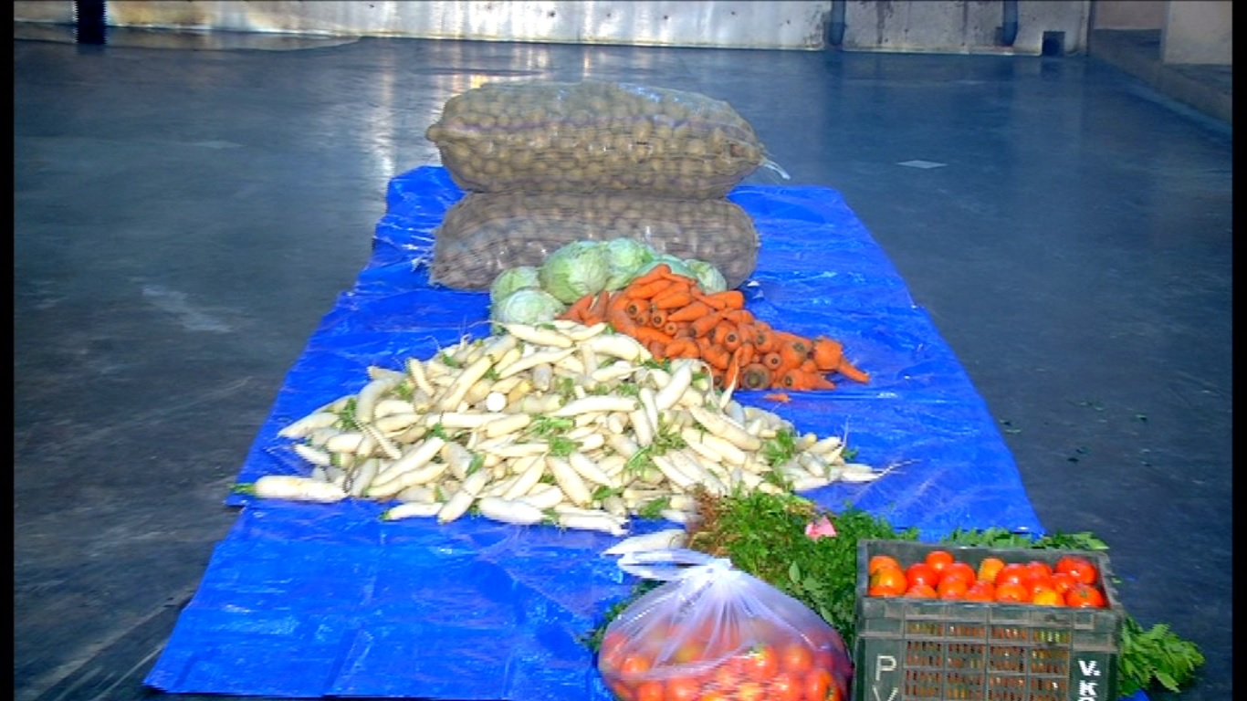
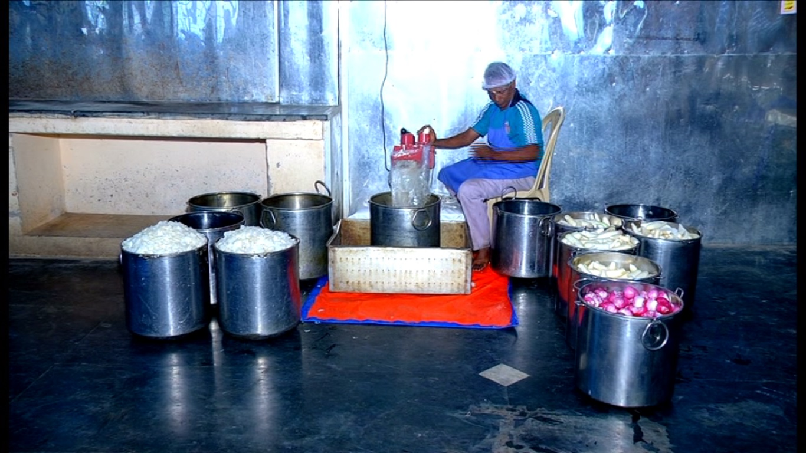
Fresh vegetable for cooking
Cutting vegetables

Slide 8
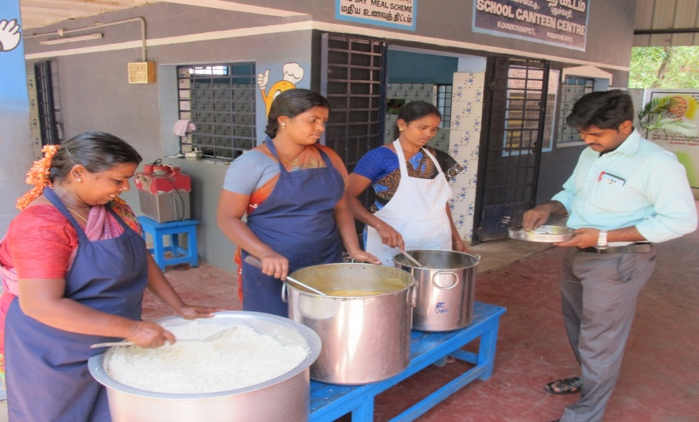
Teachers tasting the food before serving

Slide 9
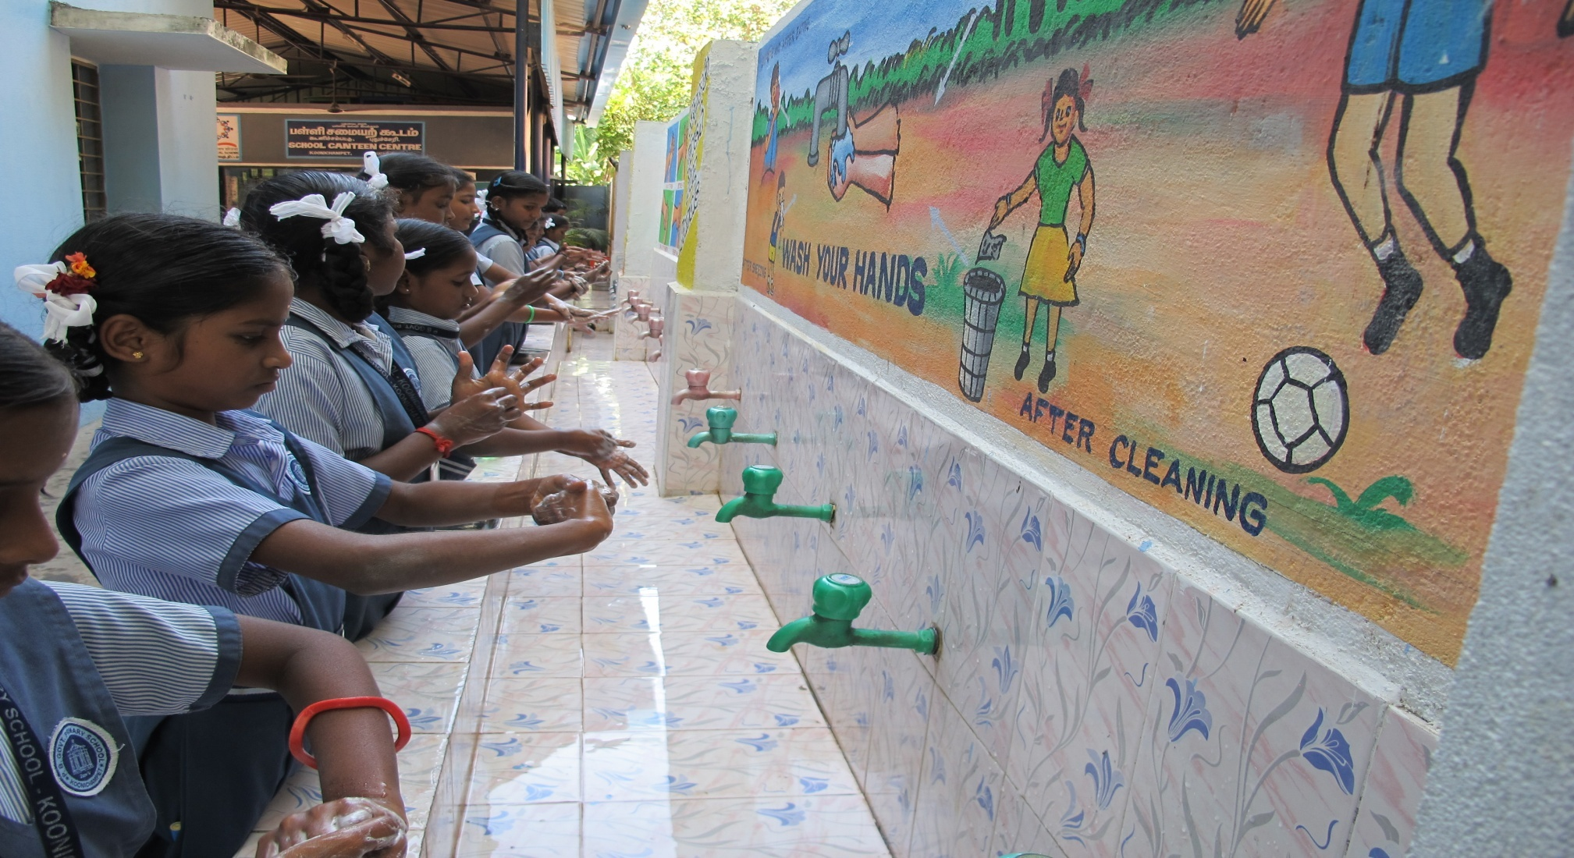
HAND WASH

Slide 10
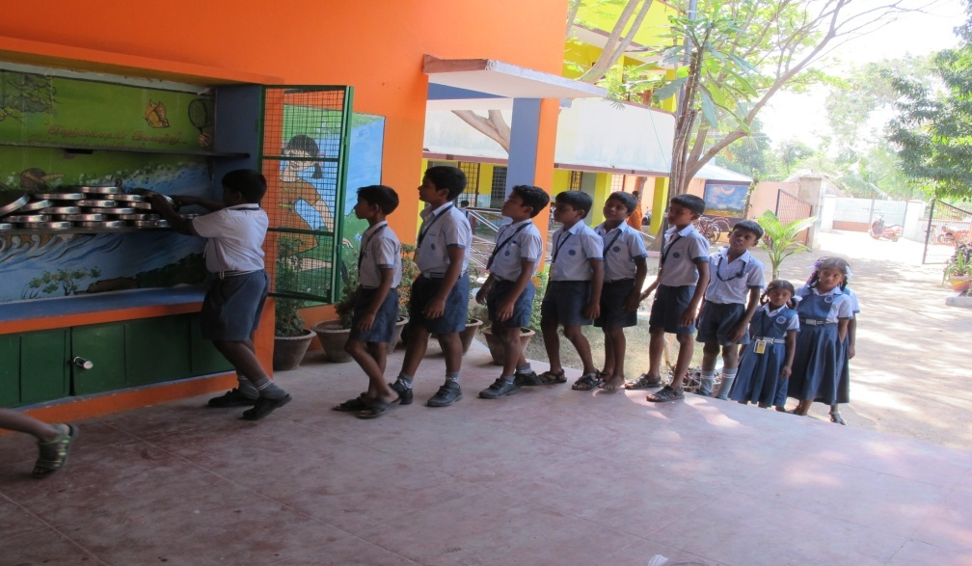
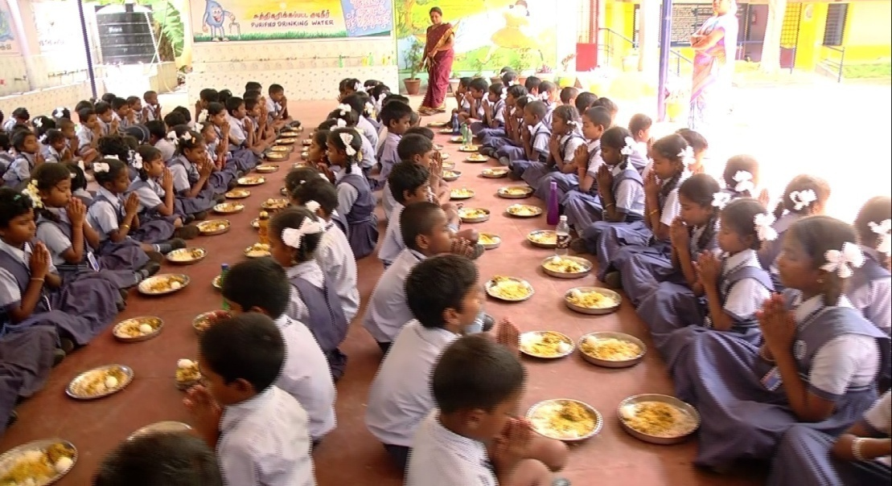
PRACTICES INVOLVED BY THE STUDENTS IN MDM

Slide 11
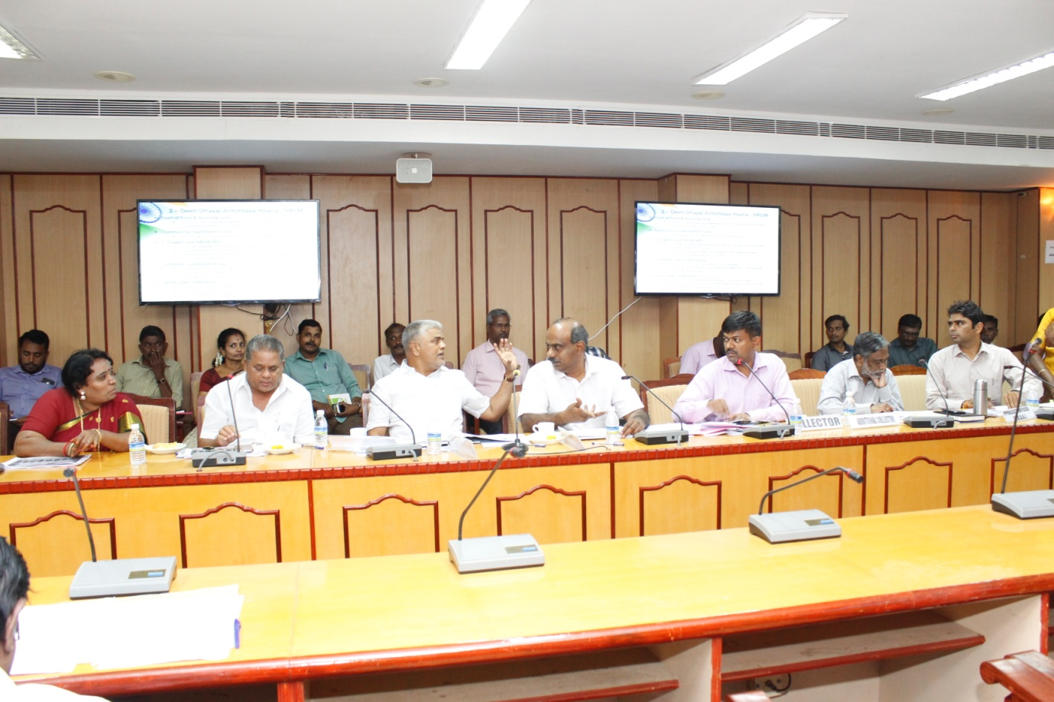
District Level Committee Meeting - Karaikal
Hon’ble M.P(Lok Sabha), Education Minister ,District Collector, & other officials , meeting held on 27.2.2018

Slide 12
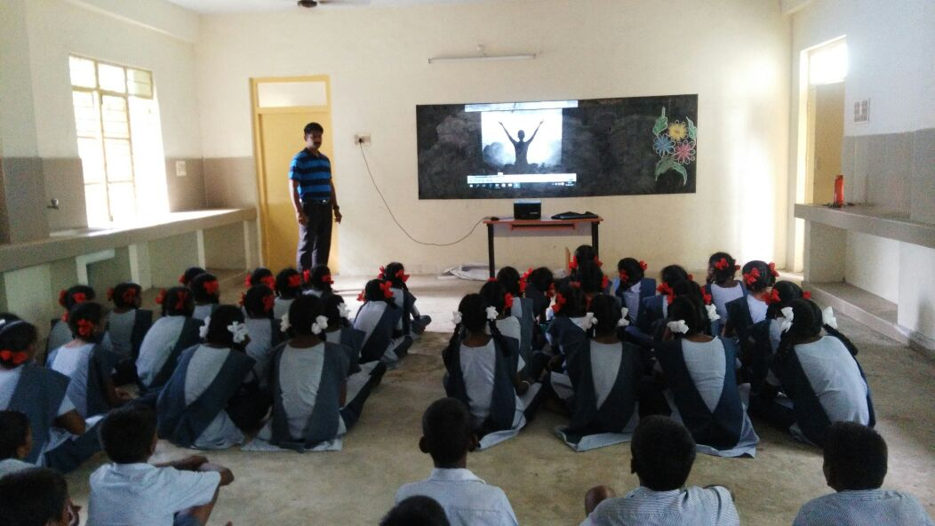
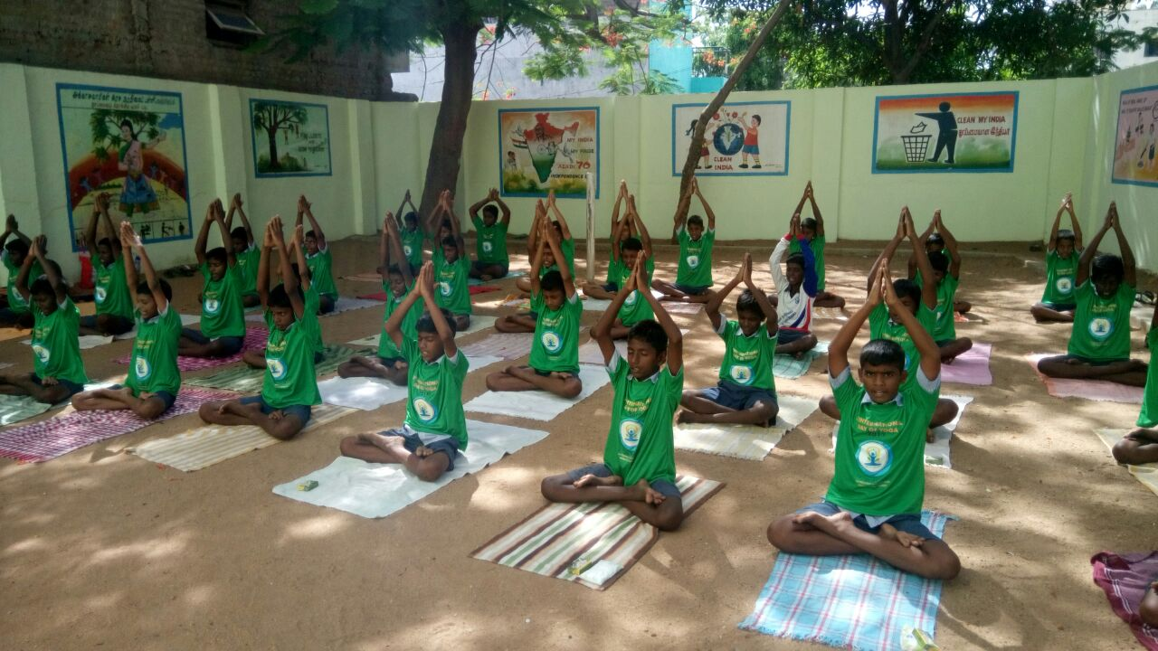
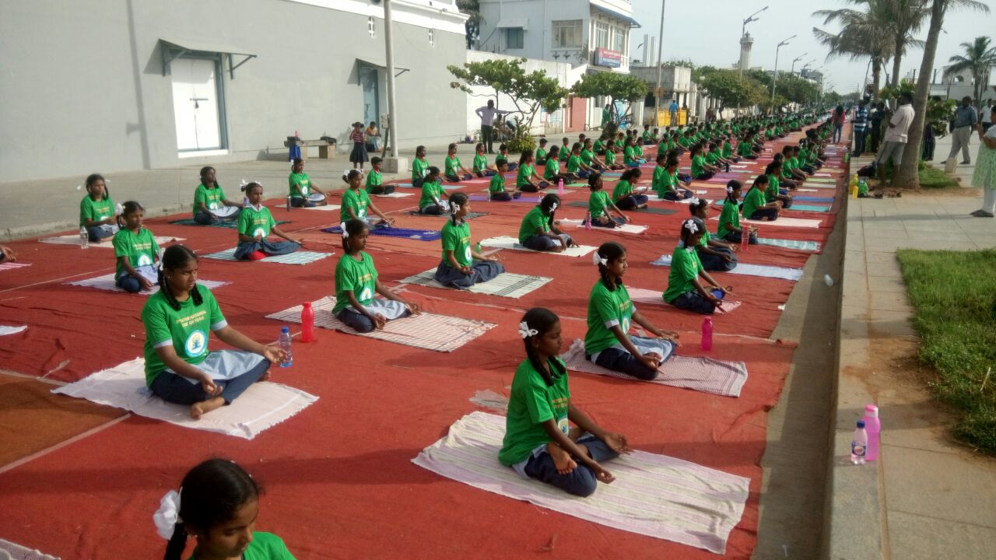
YOGA

Slide 13
SCHOOL HEALTH PROGRAM 2017-18
Total No. of Schools covered – 431
Distribution of Iron & Folic Acid, Vitamin A
& De-worming Tablets
Measles- Rubella Vaccination Campaign
Distribution of Spectacles – 315 Students
Distribution of Sanitary Napkins

Slide 14
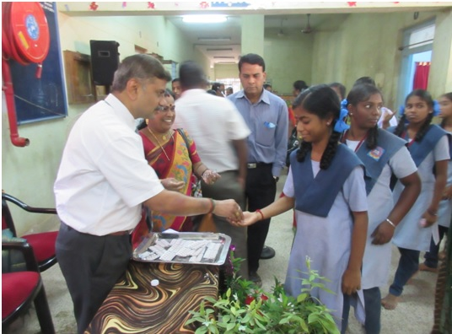
DEWORMING DAY-2017
DISTIRIBUTION OF ALBENDAZOLE TABLET

Slide 15
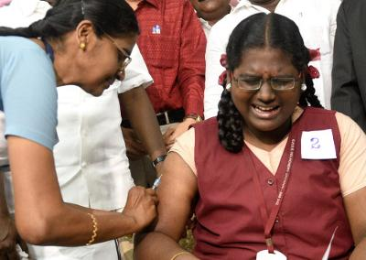
MEASLES- RUBELLA VACCINATION

Slide 16
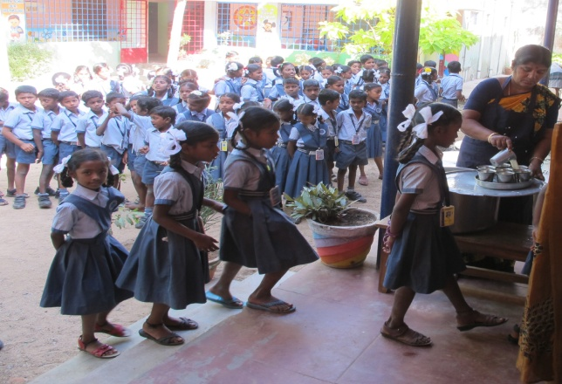
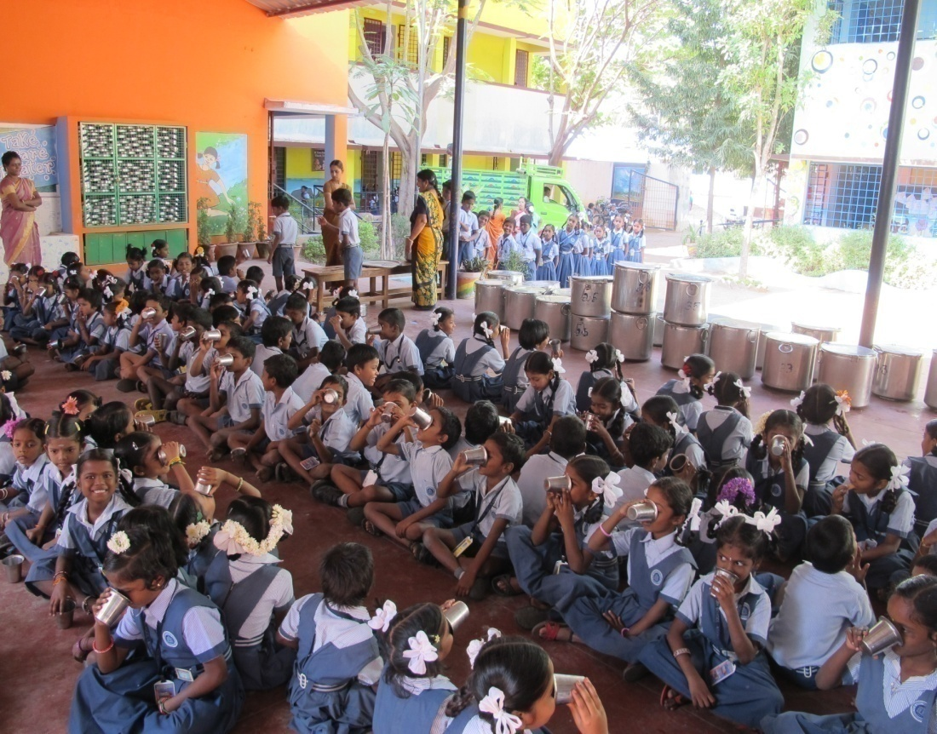
PROVIDING HOT MILK

Slide 17
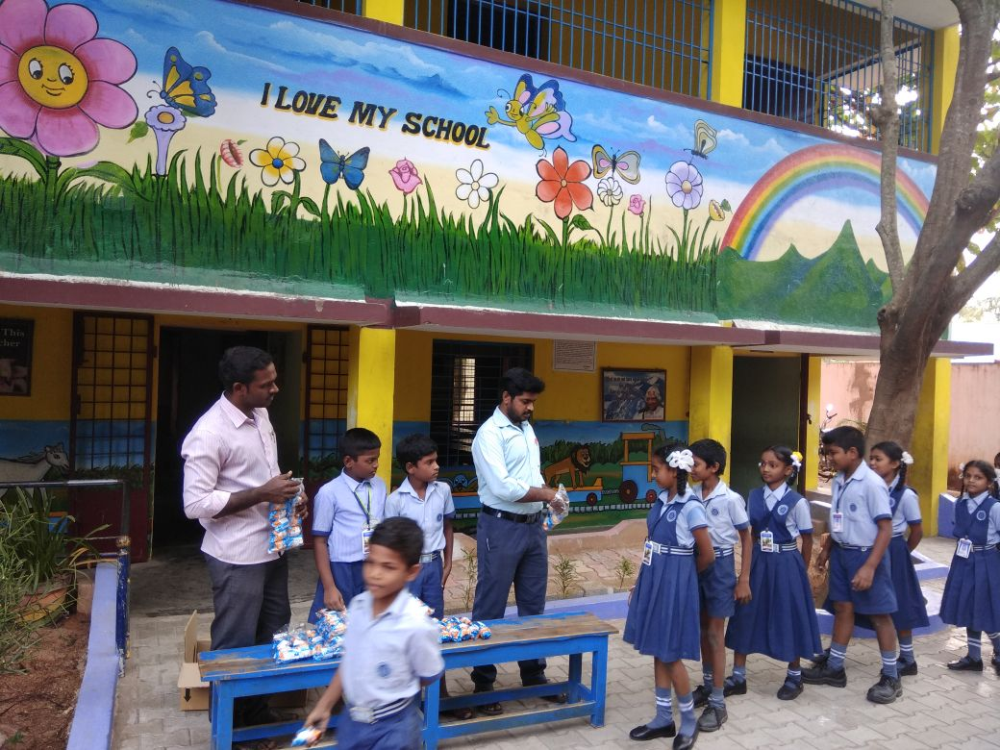
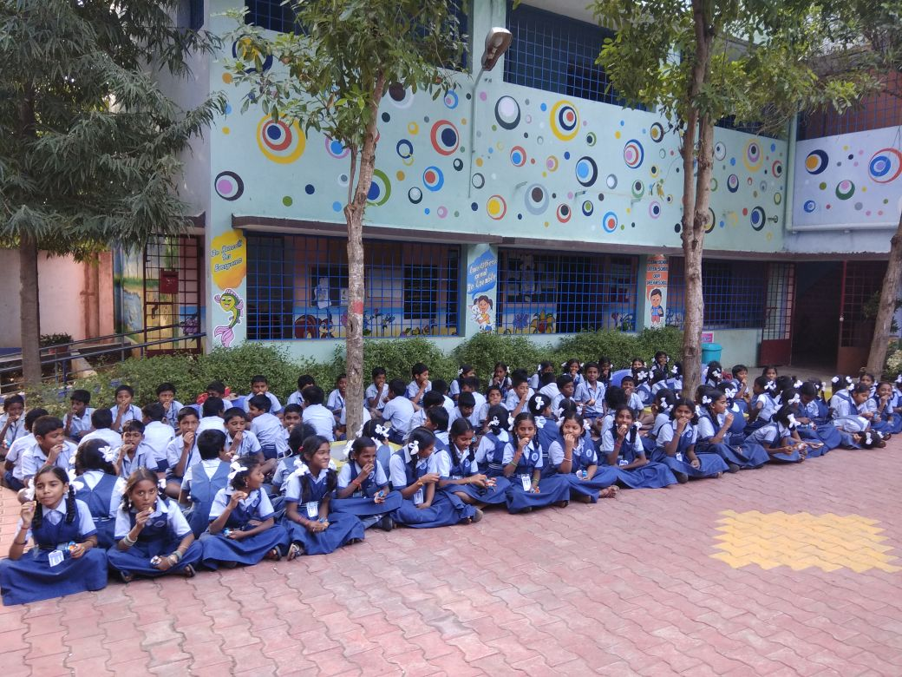
Nutritious Biscuits Serving to the Primary Children

Slide 18
BUDGET PROPOSAL FOR THE YEAR 2018-19
( in lakh)
Component | Central Assistance-60% |  |  | State 40%(Manadatory) |  |  | Grand Total
 | Primary | Upper Primary | Total | Primary | Upper Primary | Total
Cost of Food grains | 16.53 | 19.04 | 35.57 |  |  | 0 | 35.57
Cooking Cost | 136.61 | 157 | 293.61 | 90.89 | 104.52 | 195.41 | 489.02
Honorarium to Cook-cum-Helper | 33.36 | 28.5 | 61.86 | 22.24 | 19 | 41.24 | 103.1
Transportation Assistance | 4.13 | 4.76 | 8.89 |  |  | 0 | 8.89
MME | 120 | 0 | 120 |  |  | 0 | 120
Total - A | 310.63 | 209.30 | 519.93 | 113.13 | 123.52 | 236.65 | 756.58

Slide 19
PROPOSAL - MME PLAN 2018-19
UT. PUDUCHERRY
Rs. in lakhs
 | Activities | Districts
I | School Level Expenses | Puducherry | KKL | Mahe | Yanam | Total
 | Training for Cook Cum Helper | 34 | 16 | 4 | 6 | 60
 | Repair and Maintenance of Cooking devices, Utensils
 | Eating Plates (SS) upper primary
 | Storage Bin
 | Soap – Hand wash
 | Printing & Stationary
 | Sub Total | 34 | 16 | 4 | 6 | 60
II | Management, Supervision, Training, Internal Monitoring and External Monitoring. | Puducherry | KKL | Mahe | Yanam | Total
 | i) Hiring charges of manpower at various levels | 3.5 | 1 | 0.75 | 0.75 | 6
 | ii) Transport & Conveyance | 3 | 1.5 | 0.25 | 0.25 | 5
 | iii) Office expenditure | 2 | 0.5 | 0.5 | 0.5 | 3.5
 | iv) Furniture, hardware and consumables etc. | 1.5 | 0.5 | 0.25 | 0.25 | 2.5
 | v) Capacity building of officials | 1 | 0.5 | 0.5 | 0.5 | 2.5
 | vi) Publicity, Preparation of relevant manuals | 0.75 | 0.25 | 0.25 | 0.25 | 1.5
 | vii) External Monitoring & Evaluation |  |  |  |  | 0
 | MDM – IVRS MOBILE APPS & SMS | 4 | 2.5 | 0.5 | 1 | 8
 | MDM - SOCIAL AUDIT | 7 | 2.5 | 1.25 | 1.25 | 12
 | IEC Activities | 3 | 2 | 1 | 1 | 7
 | CC TV | 6 | 3 | 2.5 | 0.5 | 12
 | Sub Total | 31.75 | 14.25 | 7.75 | 6.25 | 60
 | Grand Total | 65.75 | 30.25 | 11.75 | 12.25 | 120

Slide 20
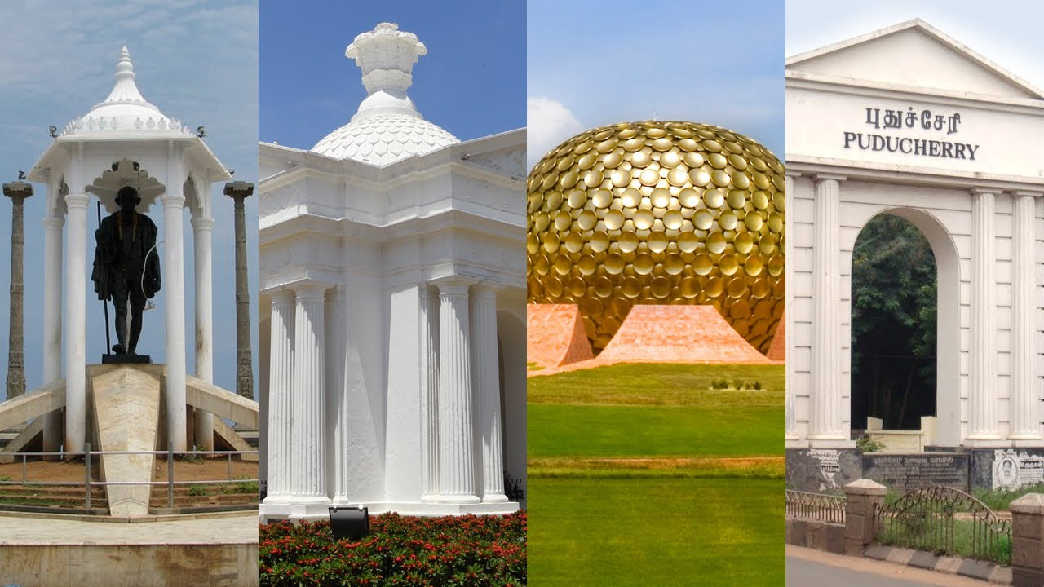
T H A N K Y O U

